Slide 1
Project Group 8
Team Members
Donald Mucharla
Niyati Ashar
Dipti Shevalekar
Satish Paraddi
Sai Gurunadh Konkapaka

Slide 2
Car Showroom Inventory Management System

Slide 3




Tech Stack
Java SE
Swing
Netbeans
CSV Data

Slide 4
Functionalities Implemented
Login with the admin credentials : Successful login will render the menu page
Customer Details, Car Details and Order Details : Add customer, car and order details using the form to be filled using Java Effects UI
CSV data read and storing in Tabular format : Used Java Effects for reading the csv data and converting and storing it in the table
Sorting : The data from the csv is sorted based on customer id , item id and displayed successfully with detail information

Slide 5
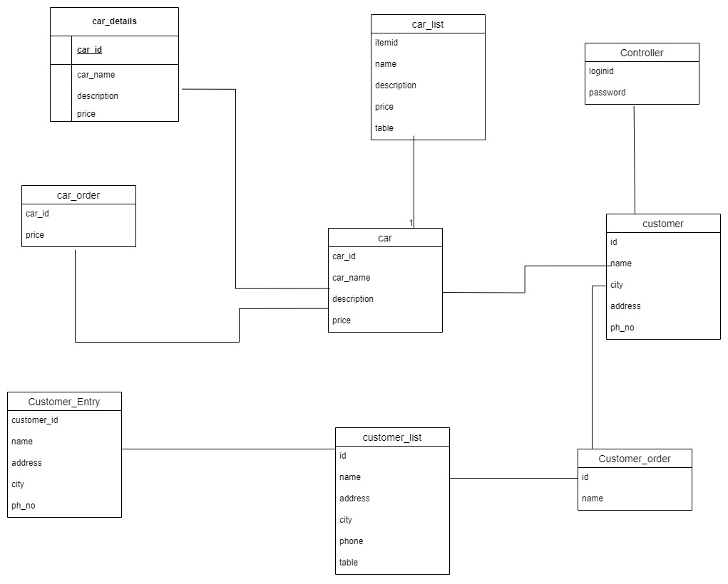
UML Diagram

Slide 6
Concepts used -
Inner Class
class CSVReader {
public void readCSV(String fileName) {
try (BufferedReader br = new BufferedReader(new FileReader(fileName))) {
String line;
while ((line = br.readLine()) != null) {
String[] values = line.split(",");
Order order = new Order(values[0], values[1], values[2], values[3], values[4], values[5], values[6], values[7]);
data.add(order);
}
} catch (IOException e) {
e.printStackTrace();
}
}
}

Slide 7
Lambda Expressions
The Comparator.comparing method uses a lambda expression to define how the Car objects are compared for sorting
public class Car_list {
public TableColumn<Car, String> itemid;
public TableColumn<Car, String> name;
public TableColumn<Car, String> description;
public TableColumn<Car, String> price;
public TableView<Car> table;
ObservableList<Car> data = FXCollections.observableArrayList();
public void ondisplay(ActionEvent actionEvent) {
try (BufferedReader br = new BufferedReader(new FileReader("Car_data.csv"))) {
String line;
while ((line = br.readLine()) != null) {
String[] values = line.split(",");
Car car = new Car(values[0], values[1], values[2], values[3]);
data.add(car);
}
} catch (IOException e) {
e.printStackTrace();
}
Comparator<Car> idComparator = Comparator.comparing(Car::getCar_id);
SortedList<Car> sortedData = new SortedList<>(data, idComparator);
// Using lambda expressions to set the cell value factories
itemid.setCellValueFactory(cellData -> cellData.getValue().getCar_idProperty());
name.setCellValueFactory(cellData -> cellData.getValue().getCar_nameProperty());
description.setCellValueFactory(cellData -> cellData.getValue().getDescriptionProperty());
price.setCellValueFactory(cellData -> cellData.getValue().getPriceProperty());
table.setItems(sortedData);
}
}

Slide 8
Inheritance
public class Driver extends Application {
@Override
public void start(Stage primaryStage) throws Exception{
Parent root = FXMLLoader.load(getClass().getResource("sample.fxml"));
primaryStage.setTitle("Welcome");
primaryStage.setScene(new Scene(root, 1000, 500));
primaryStage.show();
}
public static void main(String[] args) {
launch(args);
}
}

Slide 9
Exception Handling
The throws IOException in the method signature and the try-catch block within onSave handle potential input/output exceptions
ObservableList<Car_order> data1= FXCollections.observableArrayList();
ObservableList<Customer_ORDER> data2= FXCollections.observableArrayList();
public void onSave(ActionEvent actionEvent) throws IOException
{
int amount=(Integer.parseInt(price.getText())*Integer.parseInt(ord_quan.getText()))-(Integer.parseInt(price.getText())*Integer.parseInt(ord_quan.getText())*(Integer.parseInt(dis.getText().toString())/100));
String csvFileName = "order_data.csv"; // Adjust file name if needed
try (FileWriter fileWriter = new FileWriter(csvFileName, true)) {
fileWriter.append(order_no.getText()).append(",")
.append(date.getText()).append(",")
.append(car_id.getText()).append(",")
.append(id.getText()).append(",")
.append(ord_quan.getText()).append(",")
.append(price.getText()).append(",")
.append(dis.getText()).append(",")
.append(String.valueOf(amount)).append("\n");
} catch (IOException e) {
throw new RuntimeException(e);
}
}
public void onBack(ActionEvent actionEvent) throws IOException
{
Stage primaryStage=new Stage();
Parent root = FXMLLoader.load(getClass().getResource("menuPage.fxml"));
Scene scene = new Scene(root);
primaryStage.setScene(scene);
primaryStage.show();
}

Slide 10
Multi-threading :
This allows to perform the file reading in a background thread and then update the ObservableList on the JavaFX Application Thread
public void ondisplay(ActionEvent actionEvent) {
Task<ObservableList<Car>> task = new Task<ObservableList<Car>>() {
@Override
protected ObservableList<Car> call() throws IOException {
ObservableList<Car> data = FXCollections.observableArrayList();
try (BufferedReader br = new BufferedReader(new FileReader("Car_data.csv"))) {
String line;
while ((line = br.readLine()) != null) {
String[] values = line.split(",");
Car car = new Car(values[0], values[1], values[2], values[3]);
data.add(car);
}
}
return data;
}
};
task.setOnSucceeded(e -> {
ObservableList<Car> data = task.getValue();
Comparator<Car> idComparator = Comparator.comparing(Car::getCar_id);
SortedList<Car> sortedData = new SortedList<>(data, idComparator);
itemid.setCellValueFactory(new PropertyValueFactory<>("car_id"));
name.setCellValueFactory(new PropertyValueFactory<>("car_name"));
description.setCellValueFactory(new PropertyValueFactory<>("description"));
price.setCellValueFactory(new PropertyValueFactory<>("price"));
table.setItems(sortedData);
});
task.setOnFailed(e -> {
// Handle failure
Throwable throwable = task.getException();
throwable.printStackTrace();
});
// Start the task on a background thread
new Thread(task).start();
}}

Slide 11
Contributions
Donald Murchala - Login details
Niyati Ashar - Customer Logic, Customer List FXML
Dipti Shevalekar - Car Logic , Details, Car CSV
Satish Paraddi – Order Entry, list
Sai Gurunadh Konkapaka – Ordering system, Order_List FXML

Slide 12
Future Enhancements
Advanced Analytics Integration
Enhanced Collaboration Tools
Security and Scalability Measures
Tech Integration & AI Utilization
Mobile App Development
Regulatory Compliance Updates

Slide 13
Thank You!

